Slide 1
Nature’s Bomb
A Human-AI Collaborative Music Project by
GANTASMO
Presented by Noel Li
MTEC-345-001

Slide 2
Project Overview
GANTASMO: Daniel Joaquin Trujillo's AI music project (2018-2019)
Collaboration with Sarah Maynard
Aim: Raising awareness about environmental destruction and animal suffering

Slide 3

Song Concepts
Theme: Animals witnessing habitat devastation
Innovative approach: combining natural beauty with human-made destruction
Technical highlight: AI integration in lyrics, sound design, and vocals

Slide 4

Creative Process

Slide 5
1.Lyric development
AI collaboration: ChatGPT and Llama 3
Human-AI iterative refinement process

Slide 6
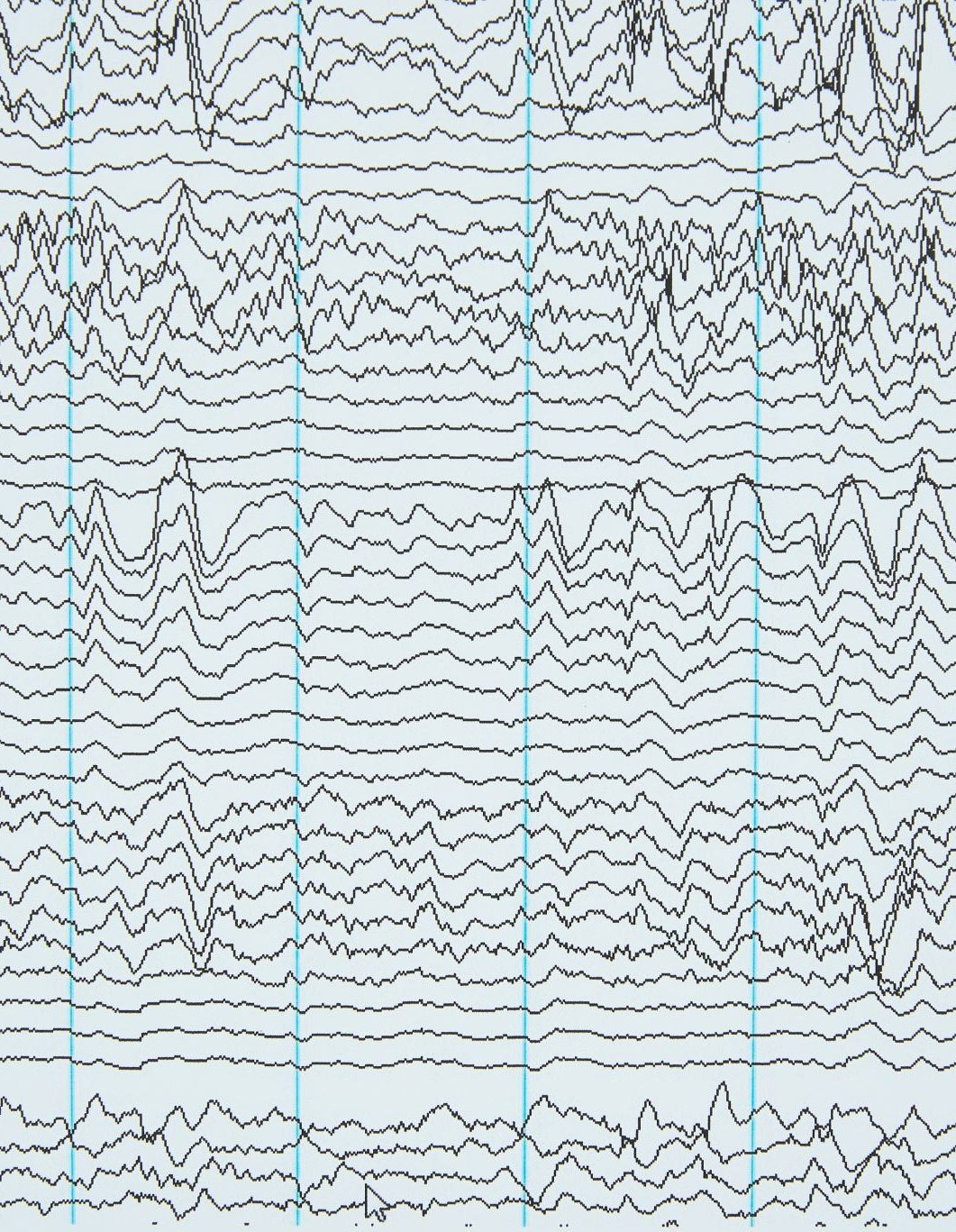
2.Sound design
Audio sample collection: Natural sounds (whale songs, extinct species vocalizations)
Human-made sounds (nuclear tests, gunfire, fracking)
Sample processing with StableAudio。

Slide 7

-StableAudio
StableAudio is an AI-powered audio generation tool developed by Stability AI. It's designed to create high-quality, original music and sound effects using artificial intelligence technology.
Core Architecture:
StableAudio likely uses a combination of advanced machine learning models, including:
Transformer-based models for sequence generation
Generative Adversarial Networks (GANs) for high-quality output
Autoregressive models for sample-by-sample generation

Slide 8
Transformer Models
1.Attention Mechanism:The core innovation of Transformers.
Allows the model to "focus" on the most relevant parts when processing an input sequence.
Analogy: When reading a long article, we pay special attention to key words and important paragraphs.
2.Self-Attention:
Each element in the input sequence can interact with all other elements in the same sequence.
Enables the model to capture complex relationships within the sequence.
3.Multi-Head Attention:
Performs multiple attention operations simultaneously.
Allows the model to understand the input from different perspectives.
Analogy: Observing an object from multiple angles.
4.Positional Encoding:Since Transformers don't inherently process sequences like RNNs, additional position information is needed.
Adds a unique identifier to each position in the input sequence.

Slide 9

END

